Slide 1

Final Presentation
Yuepeng Du
Oscar Ling
Indirakshi sreeram
andhika rakha wira laksito

Slide 2
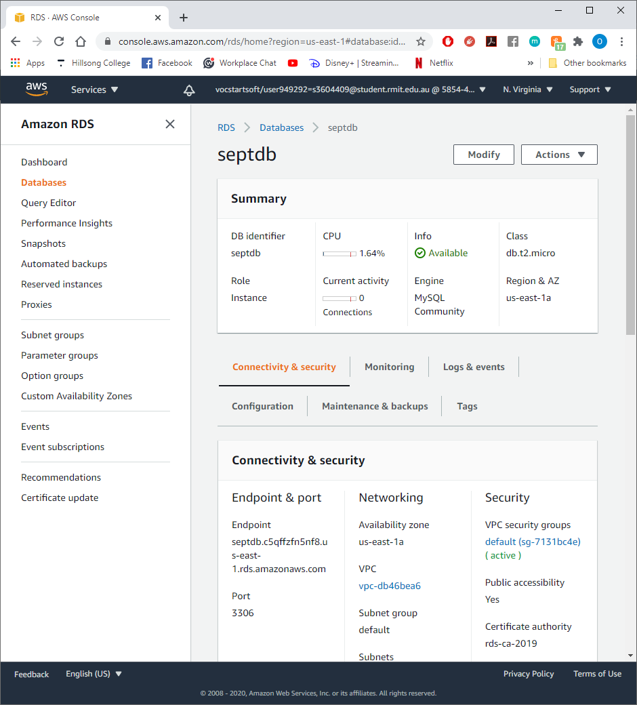
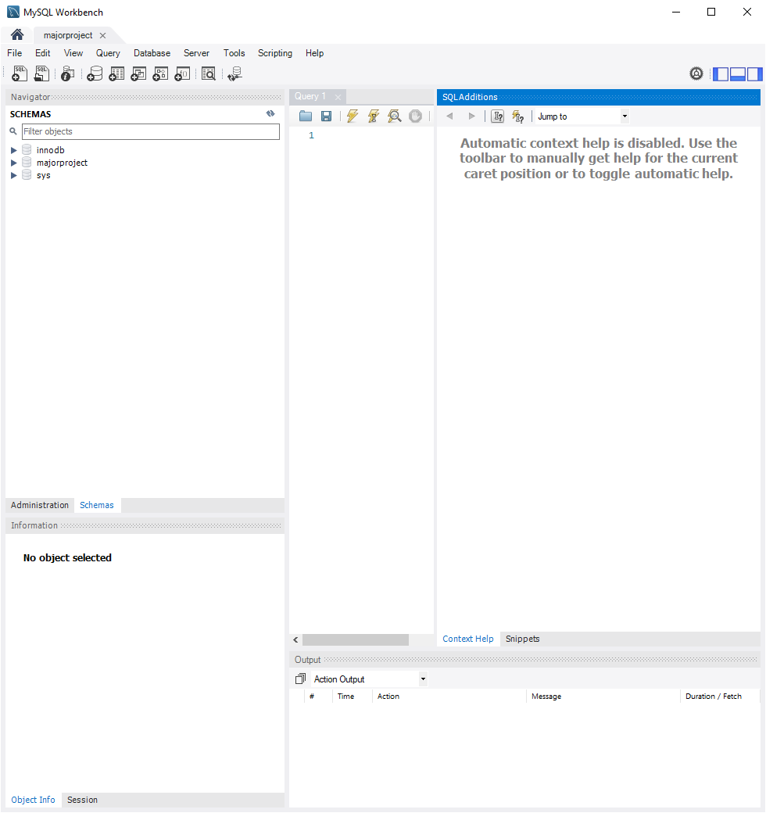
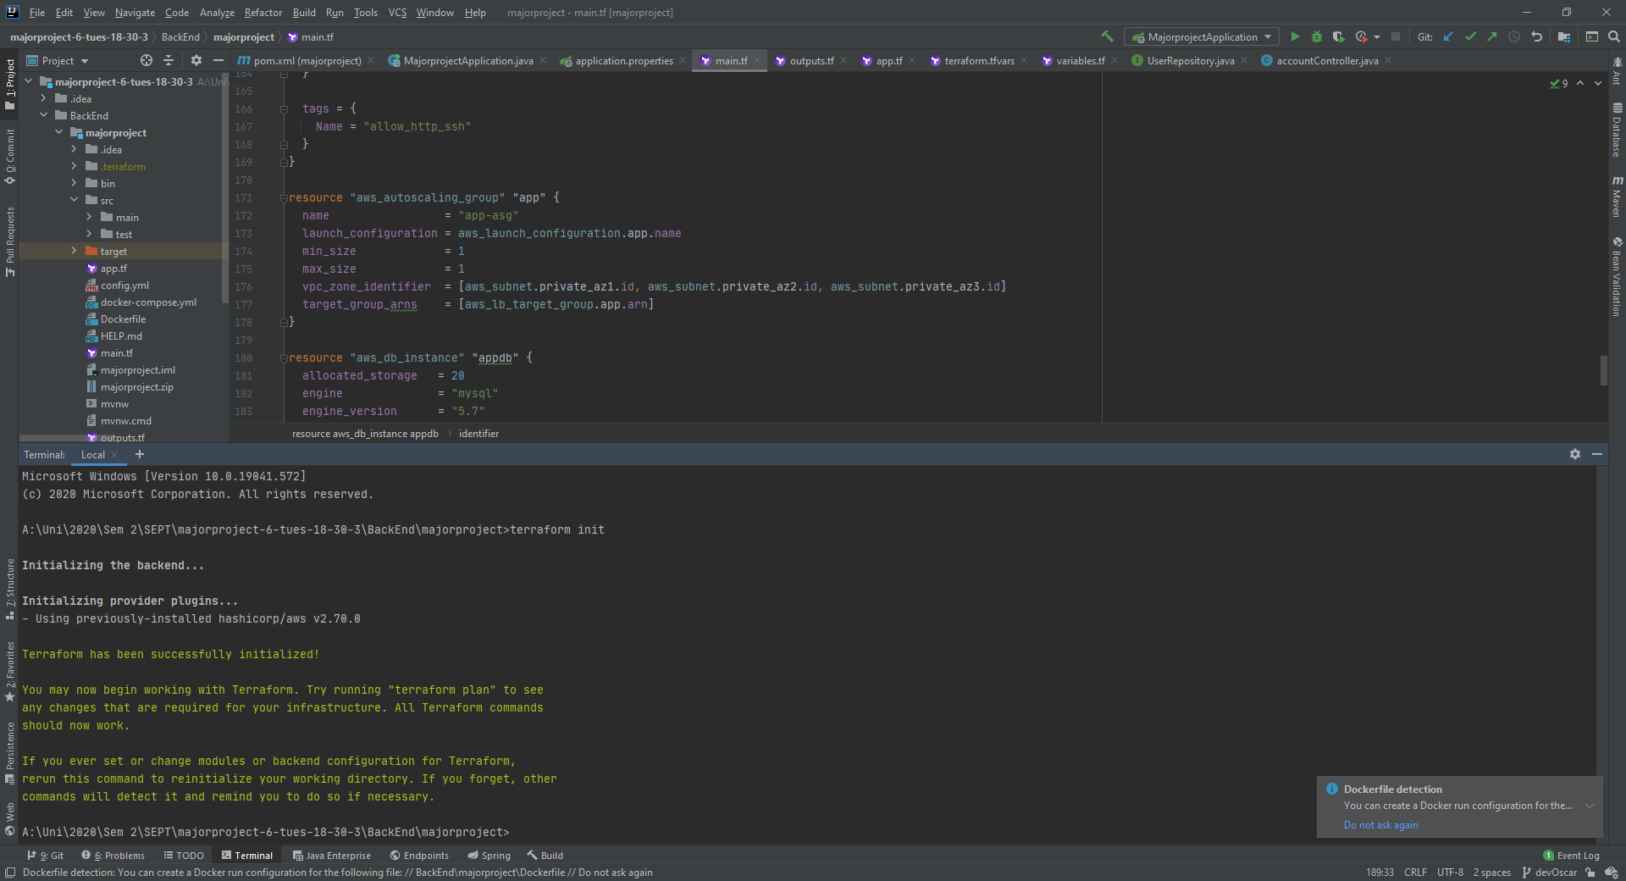

Slide 3
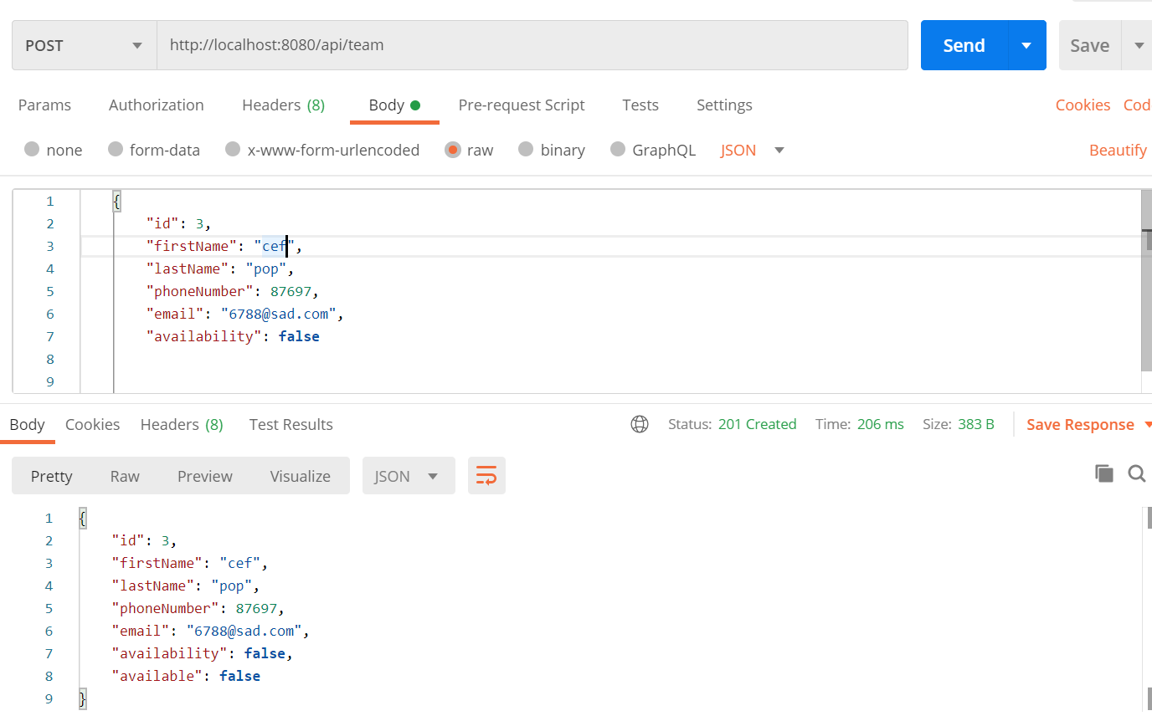
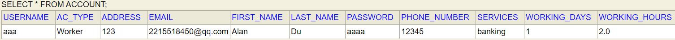
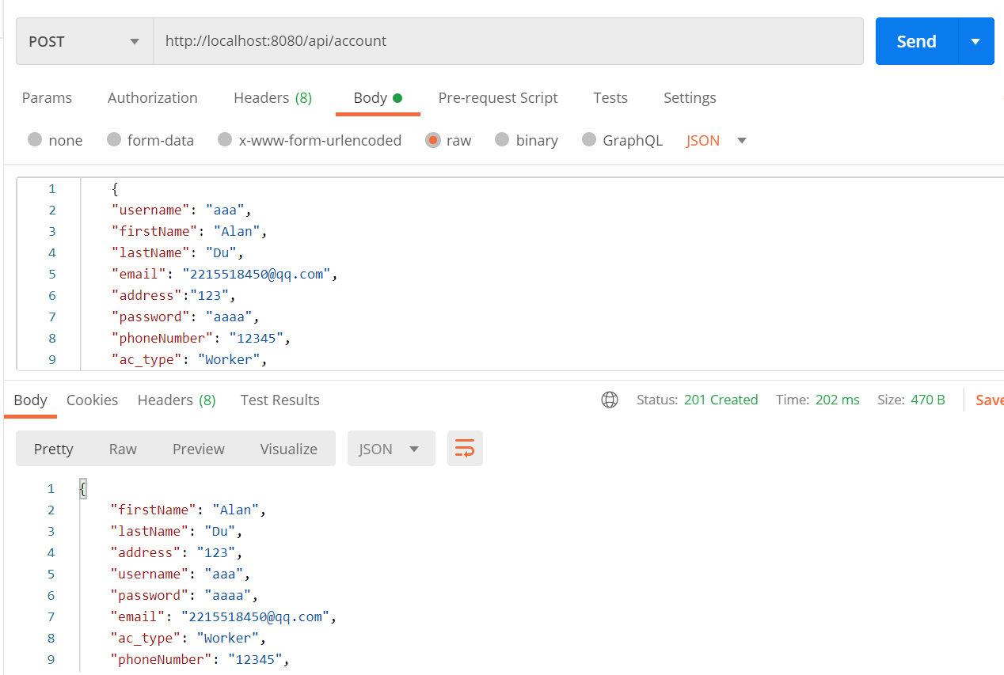
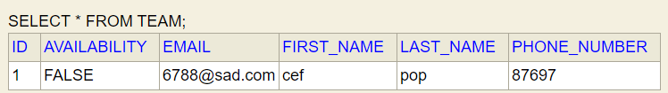
First sight of H2 database (using Postman)
Notes:
Allen -s3604409

Slide 4
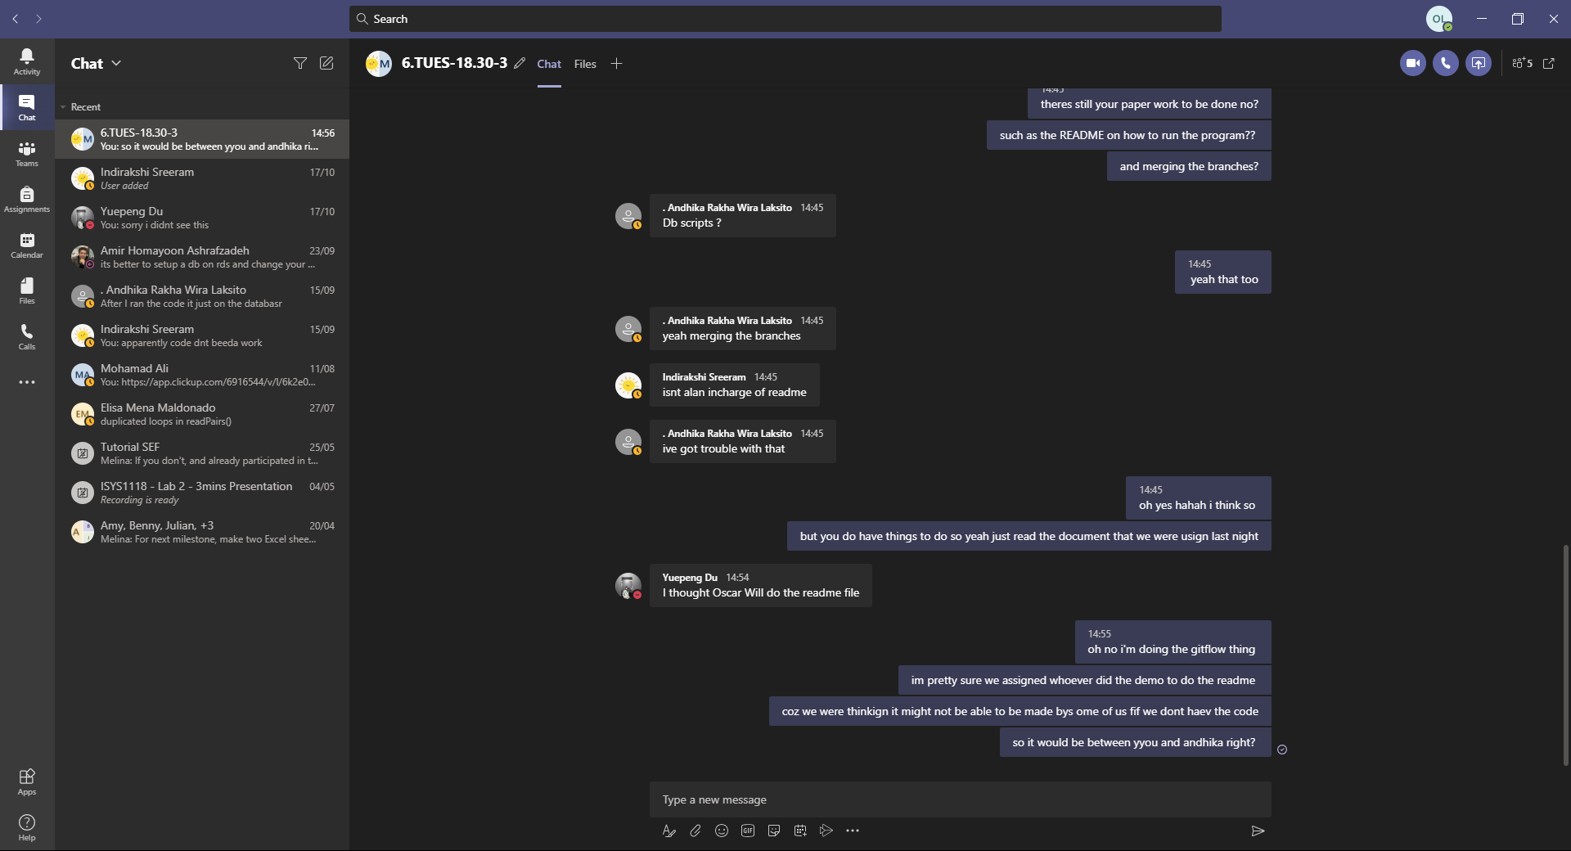

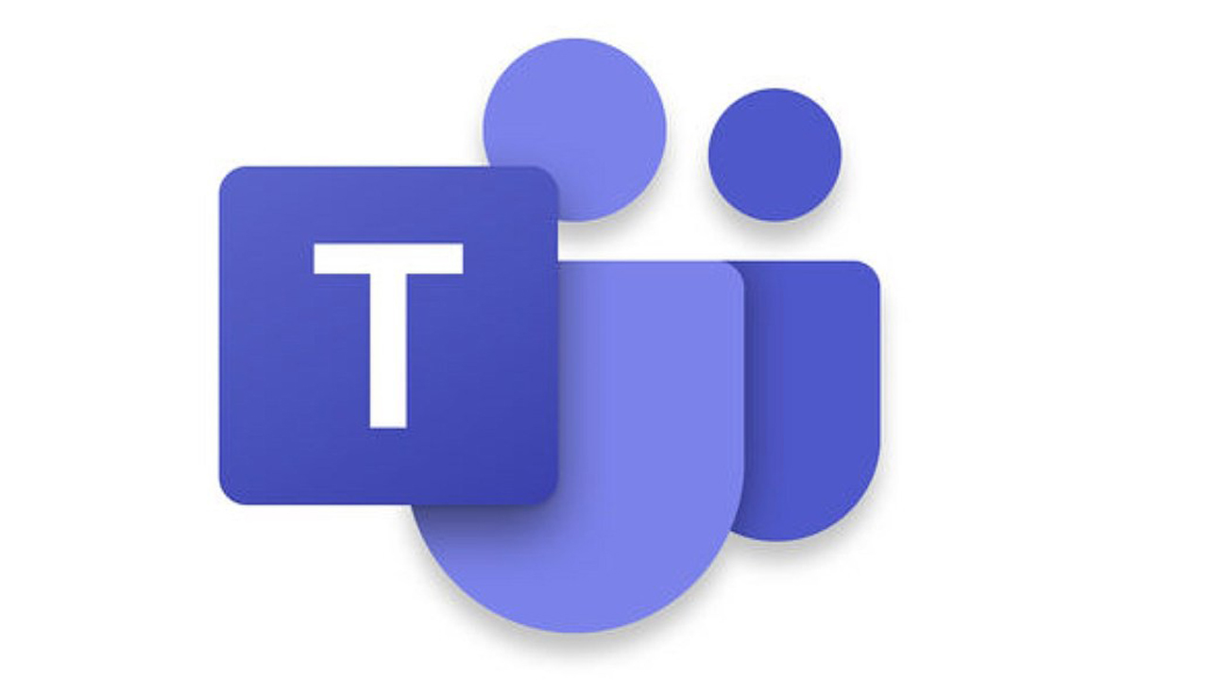
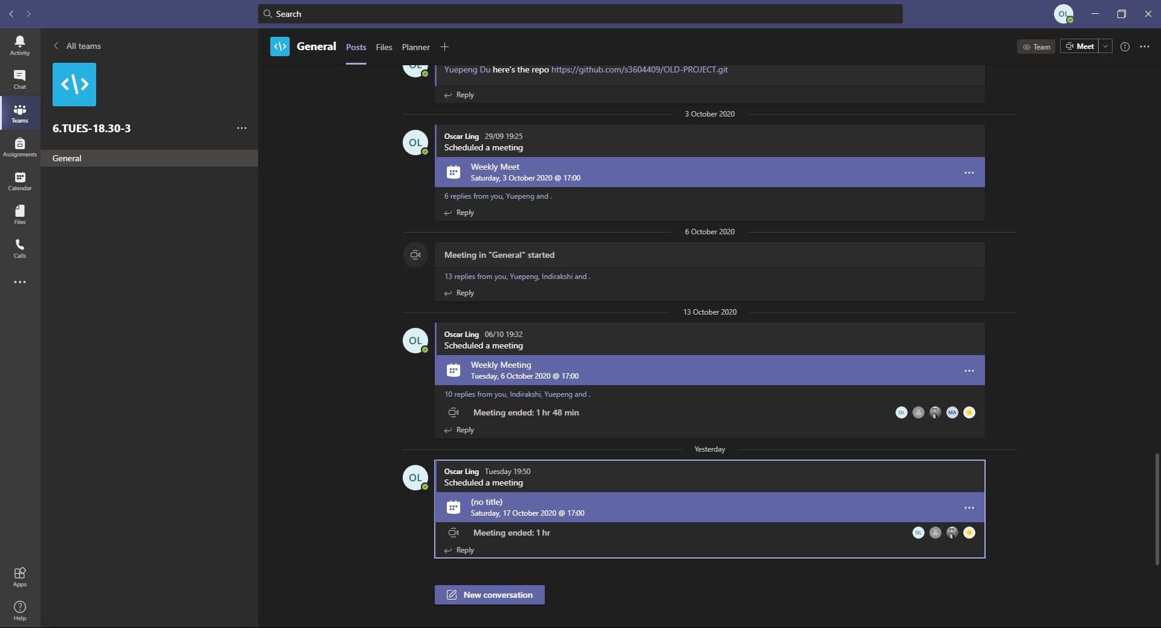
What worked Well?
Constant messages
Calls twice every week

Slide 5


TEAMWORK!

Slide 6
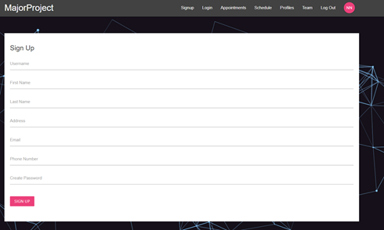
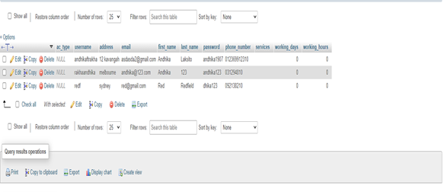
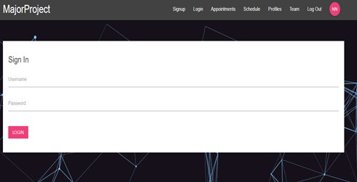
What worked well

Slide 7
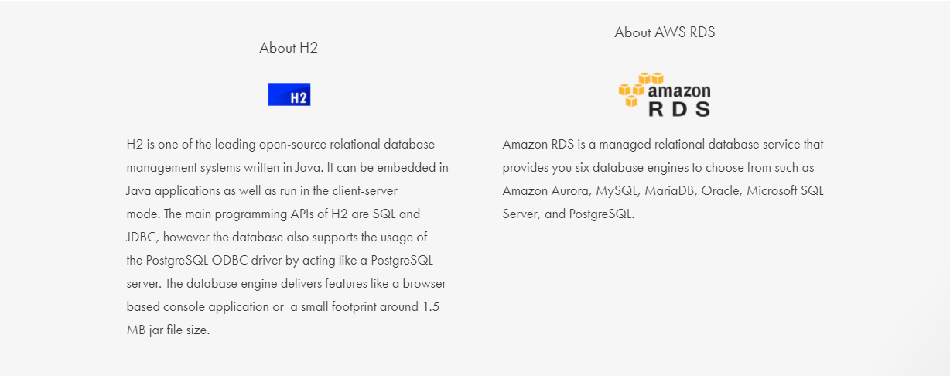
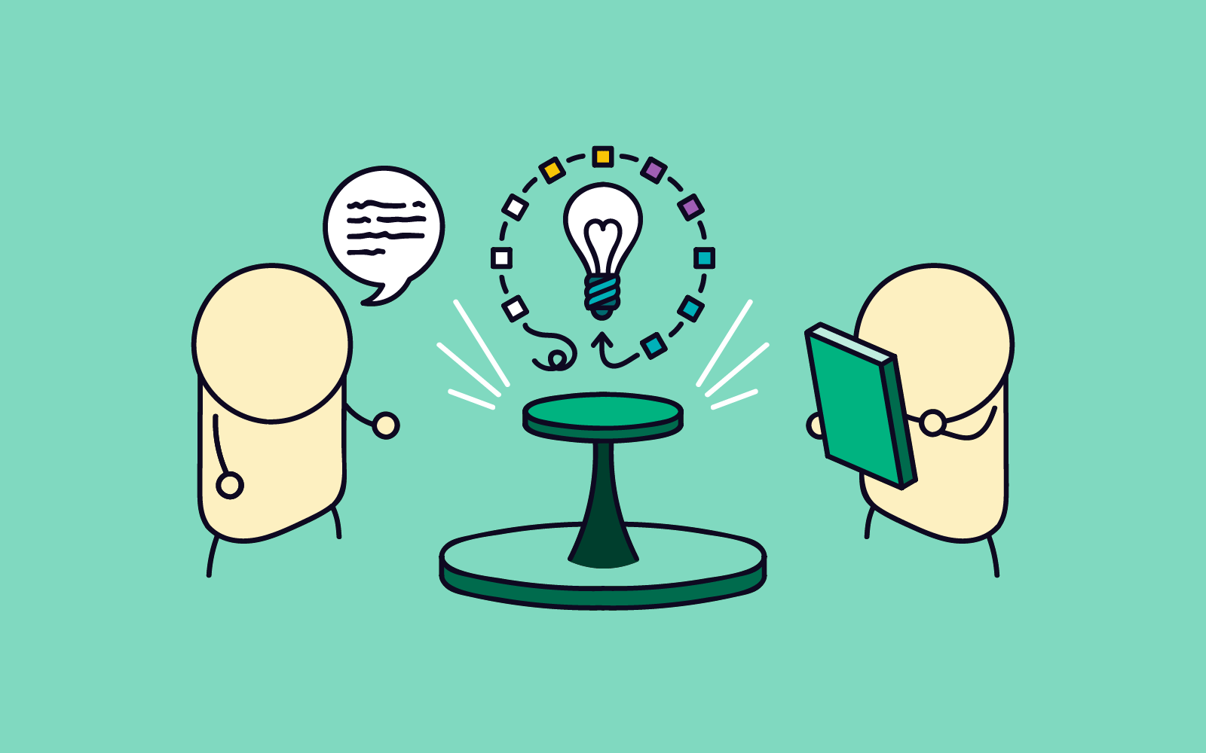
What could be improved?
They don't match unless we switch H2 into another engine!
Source: https://datavirtuality.com/connectors/integrate/h2/aws-rds/
RESEARCH!
Source: blog.optimalworkshop.com

Slide 8
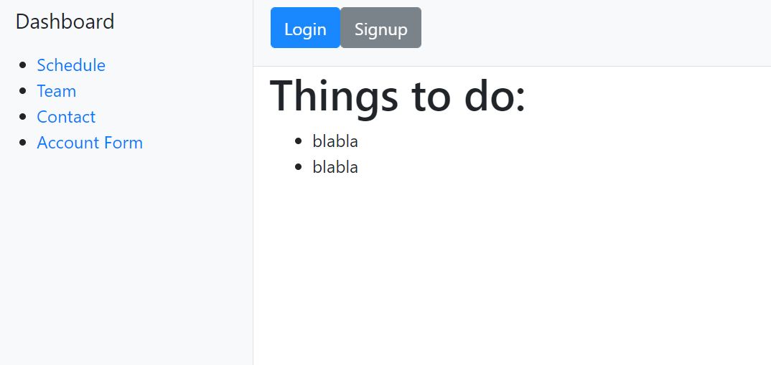
Something unexpected

Slide 9
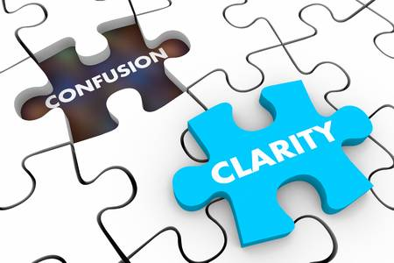
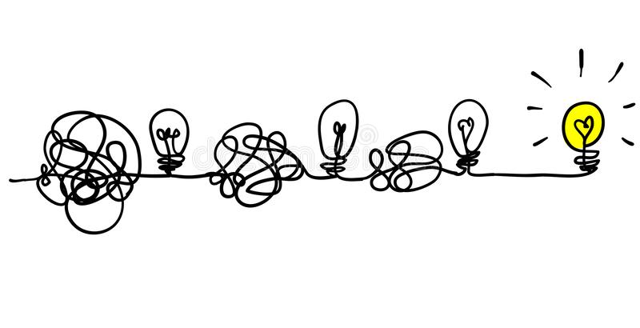
ALWAYS ASK!

Slide 10
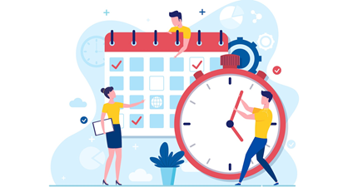

What could be improved?
Time Management
Code
Functionality

Slide 11


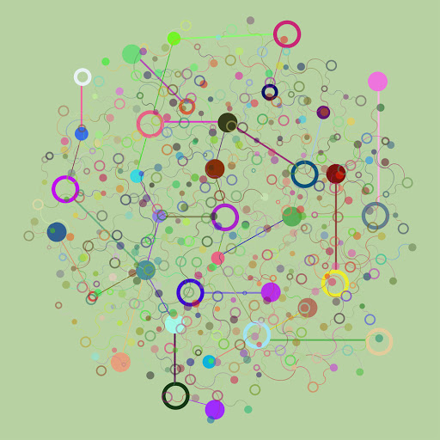

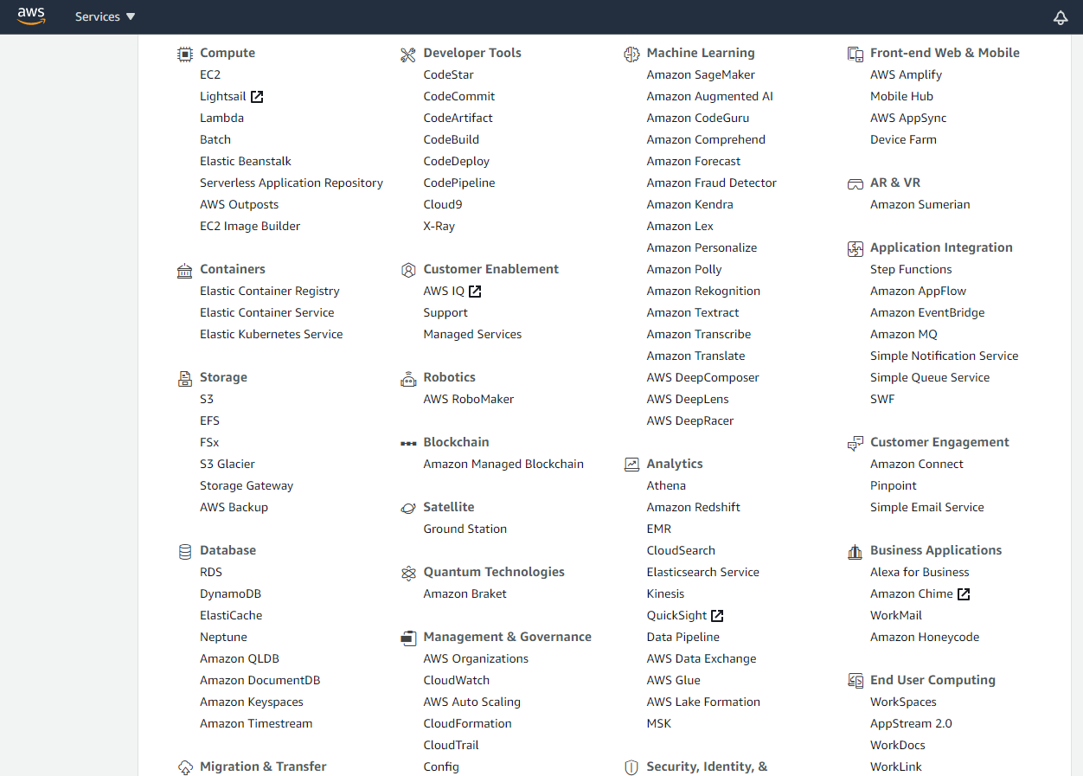
What surprised you?
Source: terraform.io
Source: docker.com
Source: circleci.com
Source: console.aws.amazon.com/
Source: rmmagazine.com

Slide 12
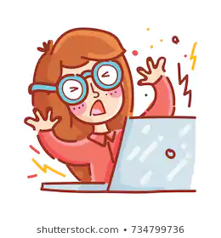



Slide 13


What surprised you?
Coding Language
Working as a team during pandemic

Slide 14
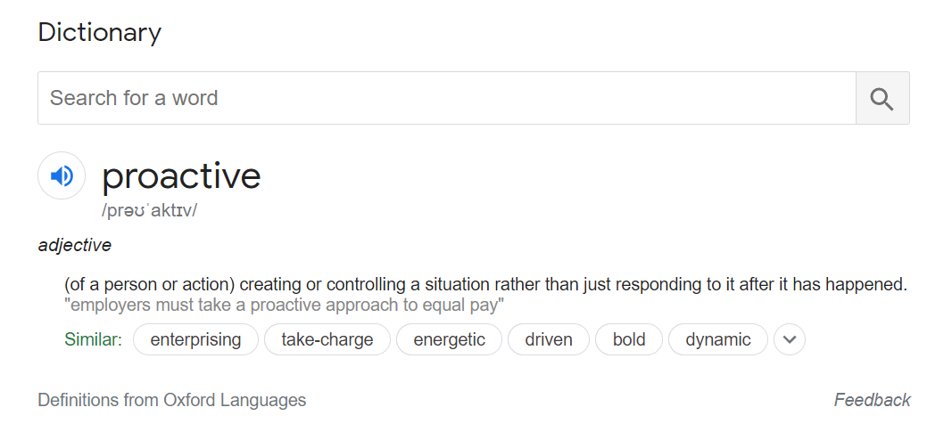
What did you learn?

Slide 15
In teamwork, silence isn’t golden, it’s deadly.
- Mark Sanborn

Slide 16






Stay organised
Set goals
Ask questions
Practice
Improve on what you already know
Focus on what to do

Slide 17


What did you learn?
- Teamwork
- Database Creation

